Slide 1
E-Recycling Product Management
SRIMATHI GOPINATH

Slide 2
ABSTRACT
2
This project aims to design andimplentation a
Robust data base management system for recycling company to optimize and streamline it’s record keeping process
Eco friendly is an plastic recycling company .
Organization wants to maintain their vendor , employee, warehouse and product details .
The database schema Will be designed To ensure data integrity and efficiency And to improve the accuracy

Slide 3
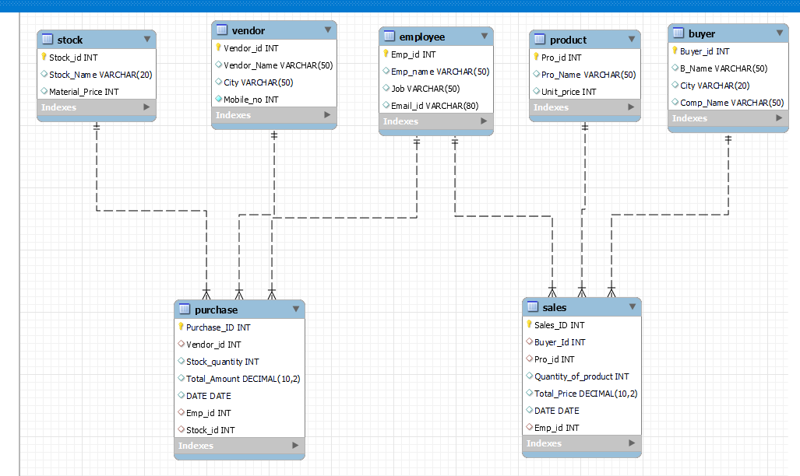
ER DIAGRAM
3

Slide 4
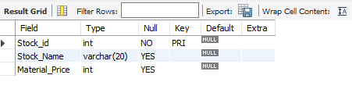
Structure of Tables
4
Table contains Stock variety name and price of the variety per Kg

Slide 5
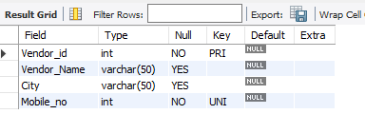
Structure of Tables
5
Table contains Vendor name and contact details

Slide 6
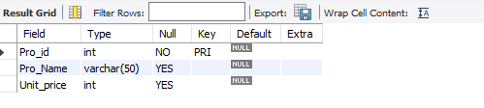
Structure of Tables
6
Table contains Product variety name and price of the variety per Kg

Slide 7
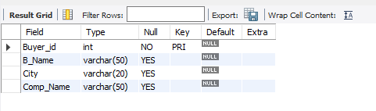
Structure of Tables
7
Table contains Buyer name and contact details

Slide 8
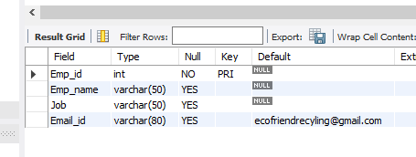
Structure of Tables
8
Table contains Employee details

Slide 9
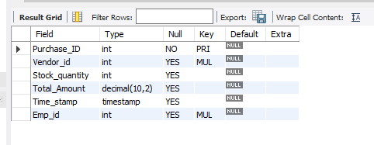
Structure of Tables
9
Table contains Purchase order details

Slide 10
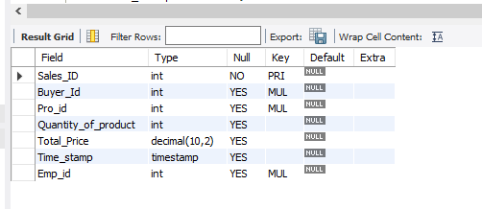
Structure of Tables
10
Table contains Sales order details

Slide 11
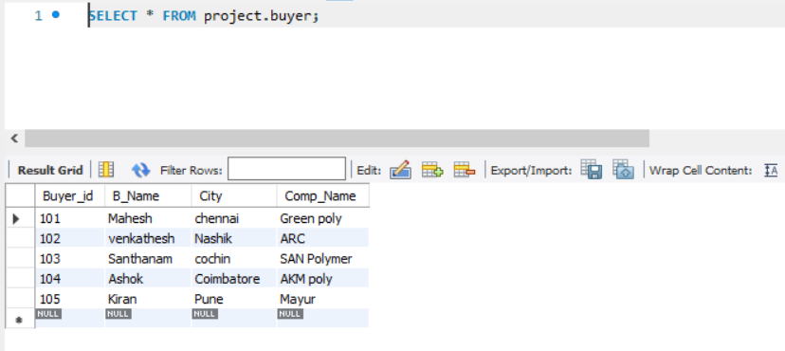
Table Records - BUYER
11

Slide 12
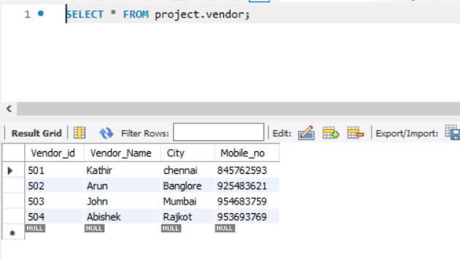
Table Record - VENDOR
12

Slide 13
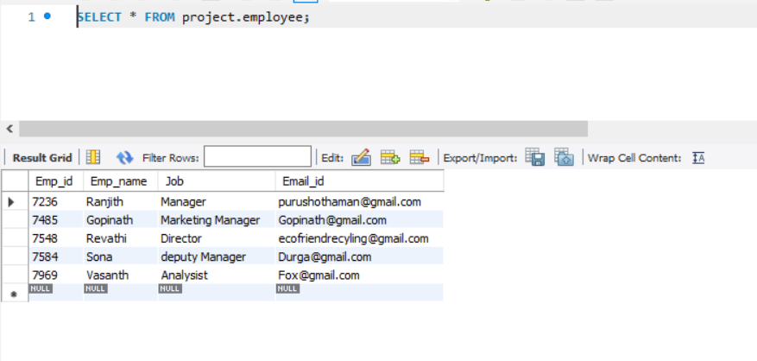
Table Record-EMPLOYEE
13

Slide 14
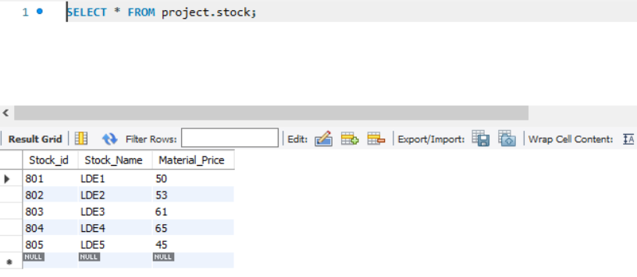
Table Record-STOCK
14

Slide 15
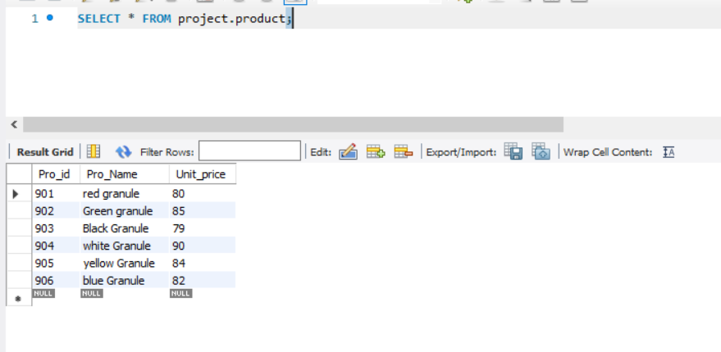
Table Record-PRODUCT
15

Slide 16
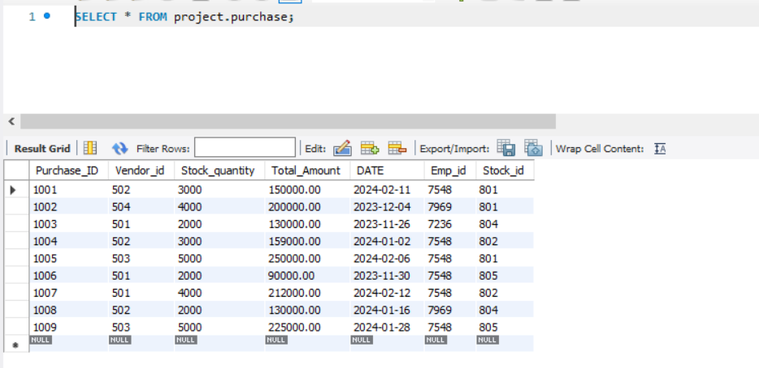
Table Record-PURCHASE
16

Slide 17
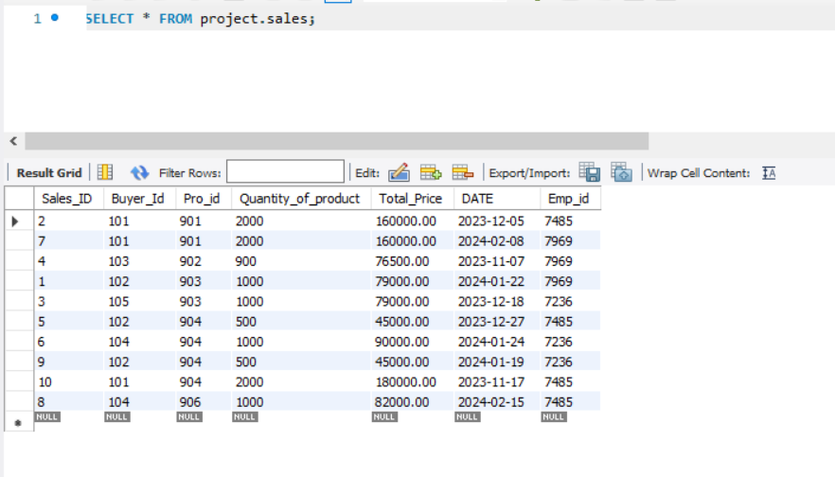
Table Record-SALES
17

Slide 18
SUBQUERY
18
A subquery is a type of query that is embedded—or nested—into a data manipulation language (DML) statement

Slide 19
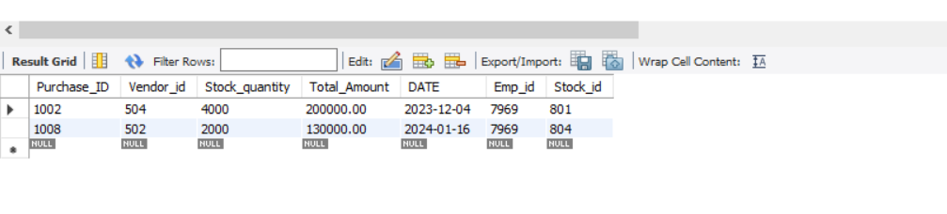
Number purchase order created by employee name
19
select * From purchase where Emp_id=(select emp_id from employee where emp_name='Vasanth’);

Slide 20
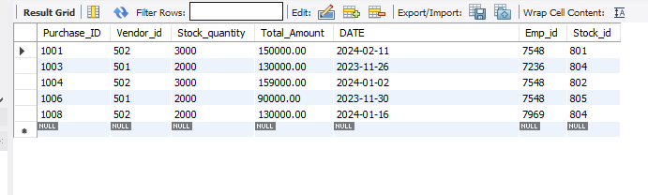
Purchase order below average of total amount
20
select* from Purchase where total_amount< (select avg(total_amount)from purchase);

Slide 21
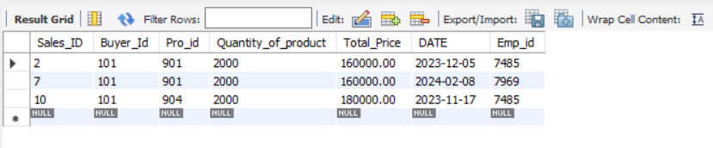
Number of Sales order based on vendor company name
21
select * From sales where buyer_id =(select buyer_id from buyer where comp_name like 'green poly' );

Slide 22
JOIN
22
A JOIN clause is used to combine rows from two or more tables, based on a related column between them

Slide 23
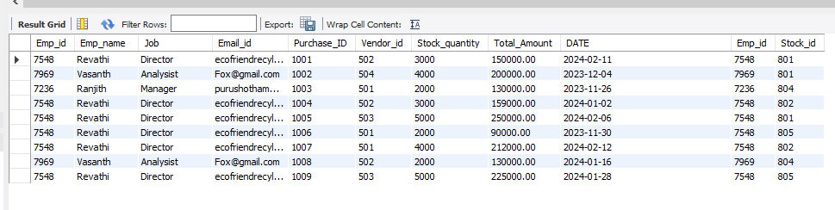
Full detail of employee who made the Purchase order
23
SELECT *FROM EMPLOYEE INNER JOIN PURCHASE EMPLOYEE.EMP_ID=PURCHASE.EMP_ID ;

Slide 24
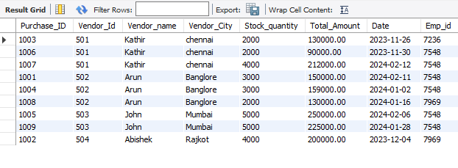
All purchase orders with vendor information
24
SELECT Purchase.Purchase_ID, Purchase.Vendor_Id, vendor.Vendor_name, vendor.city AS Vendor_City,Purchase.Stock_quantity, Purchase.Total_Amount, Purchase.Date, Purchase.Emp_id
FROM Purchase INNER JOIN vendor ON Purchase.Vendor_Id = vendor.Vendor_id;

Slide 25
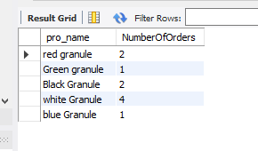
Number of orders for each product
25
SELECT product.pro_name,COUNT(sales.sales_ID) AS NumberOfOrders FROM sales
LEFT JOIN product ON product.pro_ID = sales.Pro_id
GROUP BY pro_name;

Slide 26
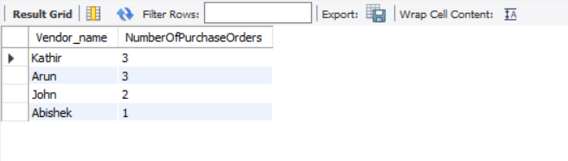
Number of Purchase order by vendor
26
SELECT Vendor.Vendor_name,COUNT(Purchase.Purchase_ID) AS NumberOfPurchaseOrders FROM Purchase LEFT JOIN Vendor ON Purchase.vendor_id = Vendor.Vendor_id GROUP BY Vendor_Name;

Slide 27
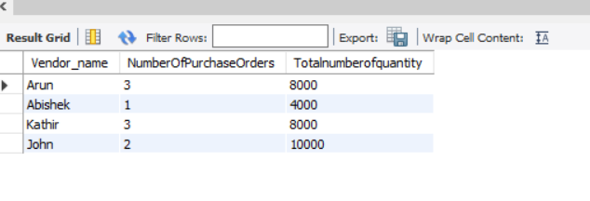
Total Number of quantity orderby Vendor
27
SELECT Vendor.Vendor_name,COUNT(Purchase.Purchase_ID) AS NumberOfPurchaseOrders,sum(stock_quantity) as Totalnumberofquantity FROM Purchase LEFT JOIN Vendor ON Purchase.vendor_id = Vendor.Vendor_id GROUP BY Vendor_Name;

Slide 28

Thank you
28
Srimathi GOPInath

